Slide 1
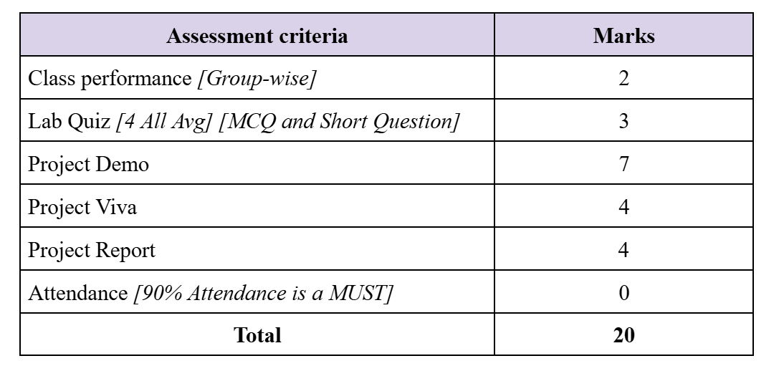

Slide 2
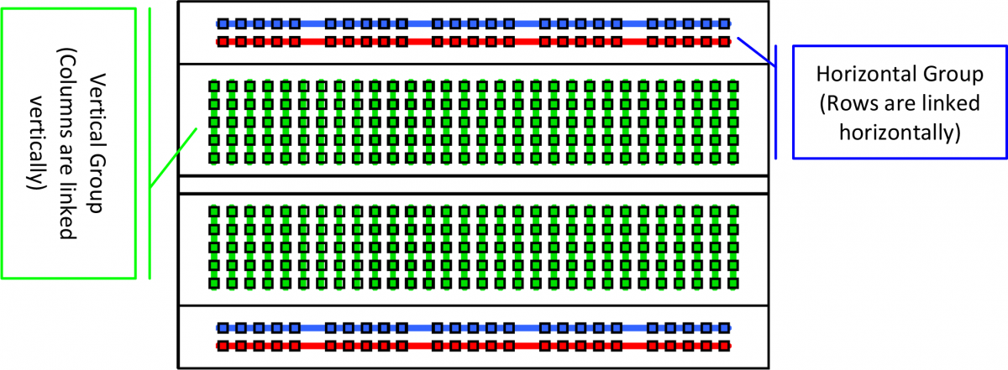

Slide 3
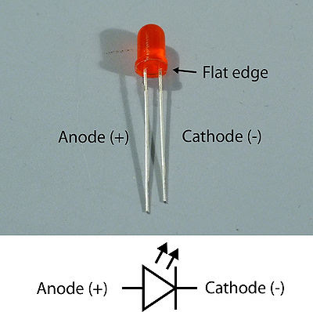

Slide 4
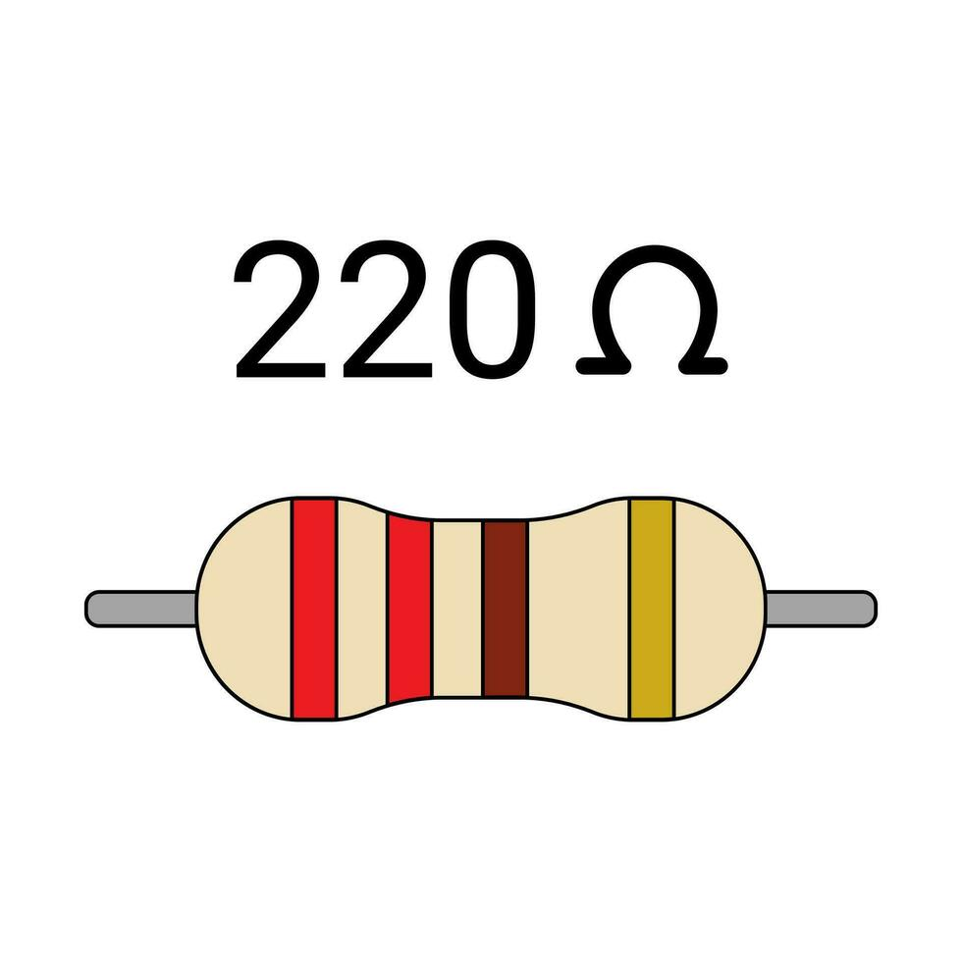
guide to decoding them:
First Band: This band indicates the first digit of the resistance value.
Second Band: Shows the second digit of the resistance value.
Third Band: Multiplier that tells you how many zeros to add to the first two digits.
Fourth Band: Tolerance, which tells you how much the resistor’s actual value can vary.
let’s take a look at a 220 ohm resistor with the color code red-red-brown-gold:
- Red (2) for the first band,
- Red (2) for the second band,
- Brown (10) for the multiplier (so 22 * 10 = 220),
- Gold (5%) for the tolerance.

Slide 5
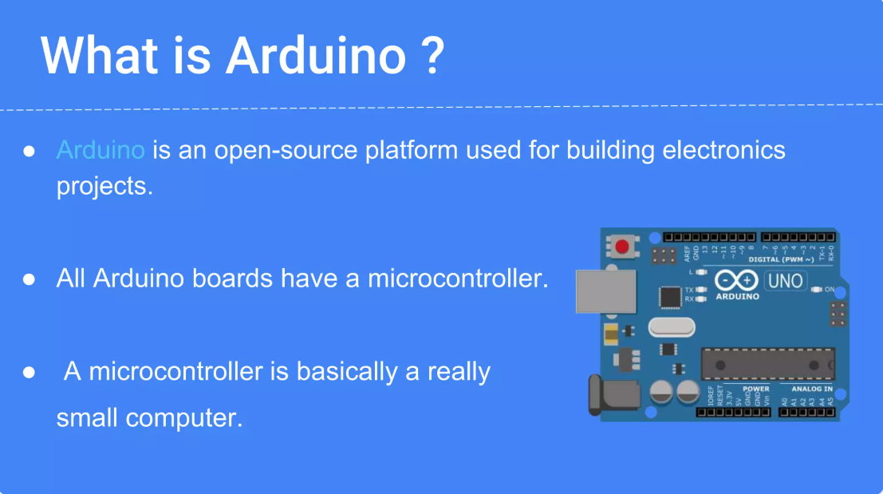

Slide 6
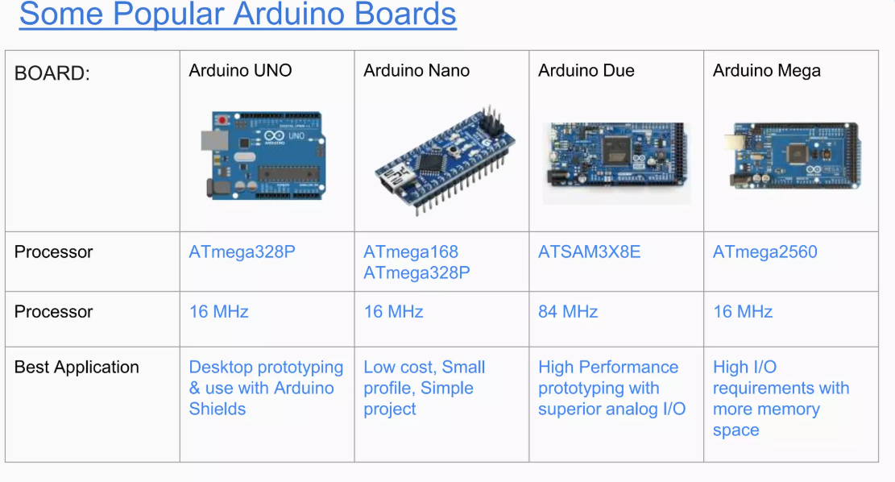

Slide 7
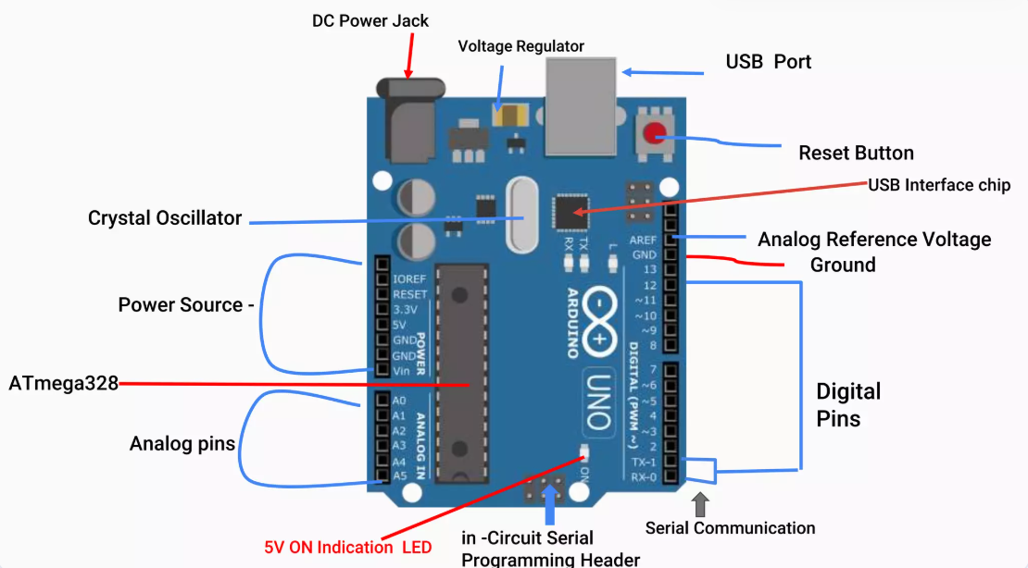
Notes:
L (LED) is mapped to Pin 13. If Pin 13 receives HIGH is glows.
# Why AREF is Necessary?
1. Improved Accuracy for Sensors
By default, the analog input range is 0–5V. If you're using a sensor that only outputs a small range (e.g., 0–1V), using 5V as a reference wastes resolution.
# With AREF set to 1V, the same ADC (10-bit = 1024 levels) now maps 0–1V into 0–1023, giving much higher resolution and accuracy.
2. Matching Sensor Output Range
Some sensors or circuits operate at voltages lower than 5V. Using a custom AREF allows better compatibility and more precise readings. Power Components
DC Power Jack
Accepts external power supply (7–12V) via an adapter or battery.
Used when USB power is not enough or portability is needed.
USB Port
Connects to your computer for programming and powering the board (5V).
Also used for serial communication.
Power Source Selector
Automatically chooses between USB power or external DC input.
Voltage Regulator
Converts the input voltage (e.g., 9V) to a stable 5V and 3.3V required by the Arduino components.
Indicators
5V ON Indication LED
Lights up when the board is powered on.
Helps confirm that the board is getting power.
Main Microcontroller
ATmega328
The brain of the Arduino.
Runs the uploaded sketch (code) and handles all inputs/outputs.
Crystal Oscillator (16 MHz)
Provides the clock signal for the microcontroller to operate.
Controls the speed of program execution and timing functions like delay() and millis().
Reset & Programming
Reset Button
Restarts the program running on the board.
Useful for testing or restarting the program.
USB Interface Chip
Converts USB signals to serial (used for programming and serial monitor).
Often ATmega16U2 on Uno.
In-Circuit Serial Programming (ICSP) Header
Allows firmware reprogramming or bootloader installation via an external programmer.
Pins
Digital Pins (0–13)
Used for digital input/output (e.g., turning an LED ON/OFF).
Pins 0 (RX) and 1 (TX) are also used for serial communication.
Analog Pins (A0–A5)
Used to read analog signals (like sensors).
Converts voltages (0–5V) into values (0–1023).
Analog Reference Voltage (AREF)
Allows use of an external voltage reference for analog readings (instead of default 5V).
Ground (GND)
Common ground connection for all circuits.
Important for completing electrical circuits.
Power Header (3.3V, 5V, GND, Vin, IOREF, RESET)
3.3V: Power output for 3.3V devices.
5V: Main regulated 5V power output.
GND: Ground pins.
Vin: Raw input voltage from DC jack.
IOREF: Voltage reference for connected shields.
RESET: Can be used to manually reset the board.
Communication
Serial Communication (TX, RX LEDs & Pins)
TX (Transmit) and RX (Receive) indicators blink when data is being transferred between Arduino and PC.

Slide 8
Digital Pins (0–13): Can be used as input or output pins. They operate at 5V and can provide or receive a maximum of 40mA current.
Analog Pins (A0–A5): Used to read analog signals (e.g., from sensors). They have a resolution of 10 bits (0–1023).
Power Pins:
5V and 3.3V: Provide regulated voltage output.
GND: Ground pins.
Vin: Input voltage for external power supply.
Special Pins:
PWM (~) Pins: Digital pins capable of Pulse Width Modulation (e.g., pins 3, 5, 6, 9, 10, 11).
UART Pins: Used for UART communication (TX: pin 1, RX: pin 0).
SPI Pins: Used for SPI communication (MOSI: pin 11, MISO: pin 12, SCK: pin 13, SS: pin 10).
I2C Pins: Used for I2C communication (SDA: A4, SCL: A5)

Slide 9
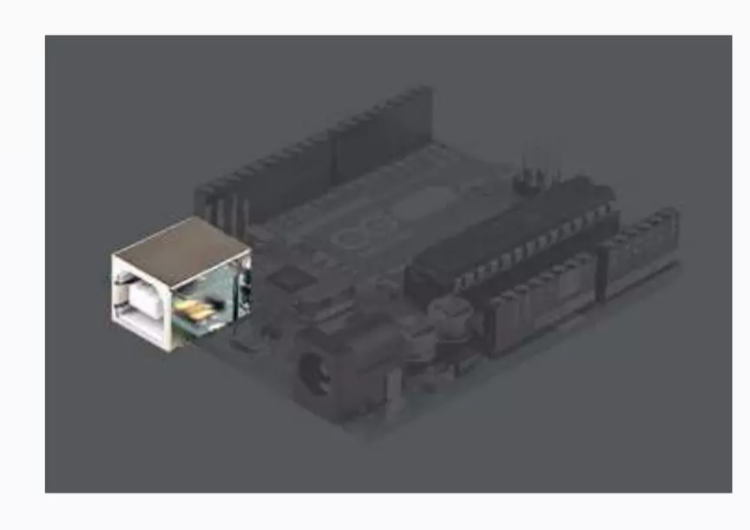
USB Port
This is a printer USB port used to load program from the Arduino IDE onto the Arduino board. The board can also be powered through this port.

Slide 10
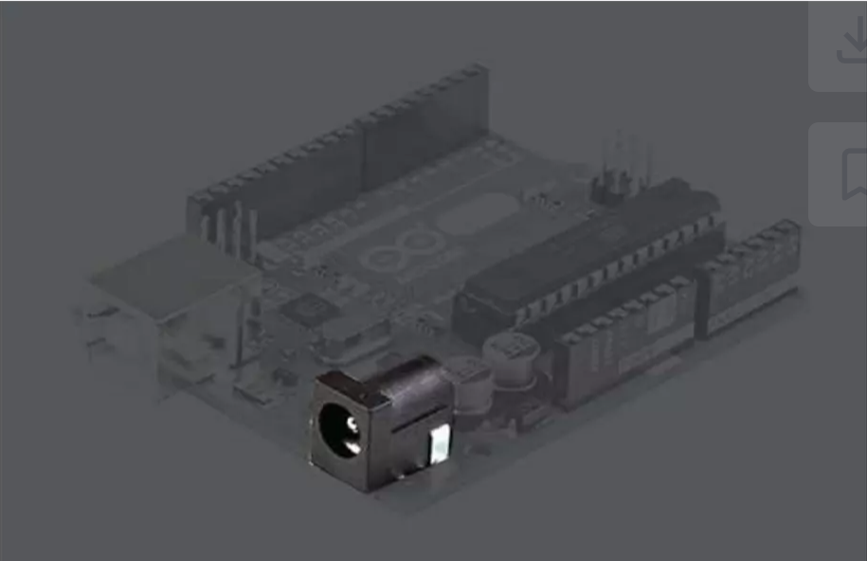

Power port:
The Arduino board can be powered through an AC-to-DC adapter or a battery. The power source can be connected by plugging in a 2.1mm center-positive plug into the power jack of the board.
The Arduino UNO board operates at a voltage of 5 volts, but it can withstand a maximum voltage of 20 volts. If the board is supplied with a higher voltage, there is a voltage regulator (it sits between the power port and USB connector) that protects the board from burning out.
Notes:
There are primarily 3 ways to power the arduino, one using power jack, then use USB and the other one is Vin

Slide 11
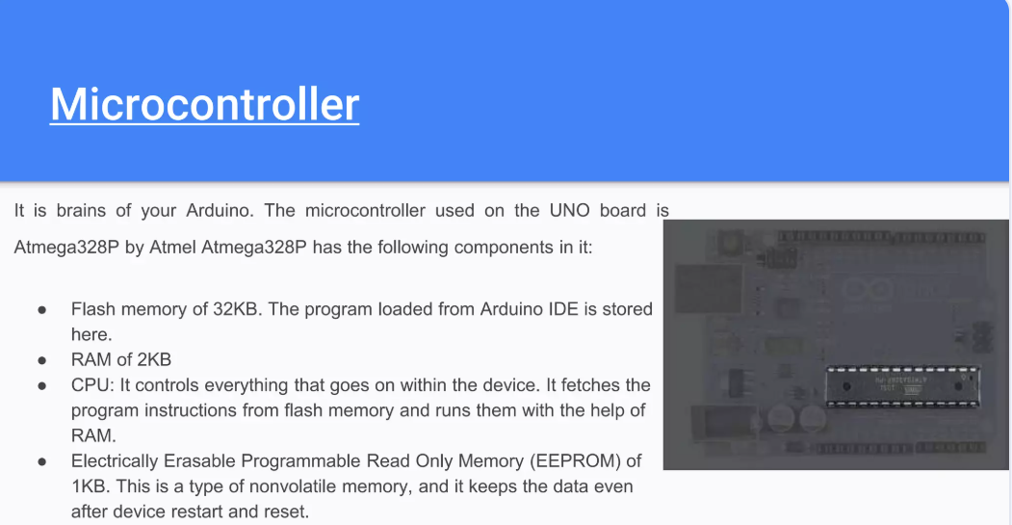
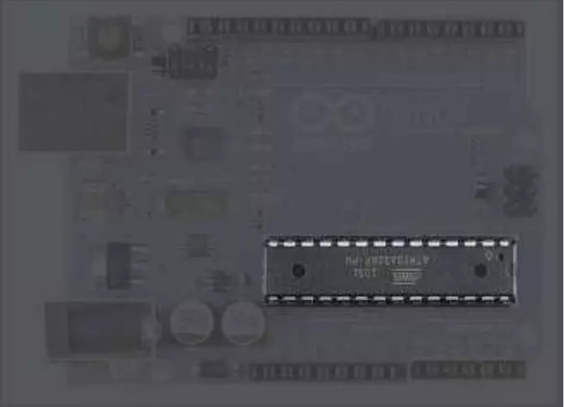

Slide 12
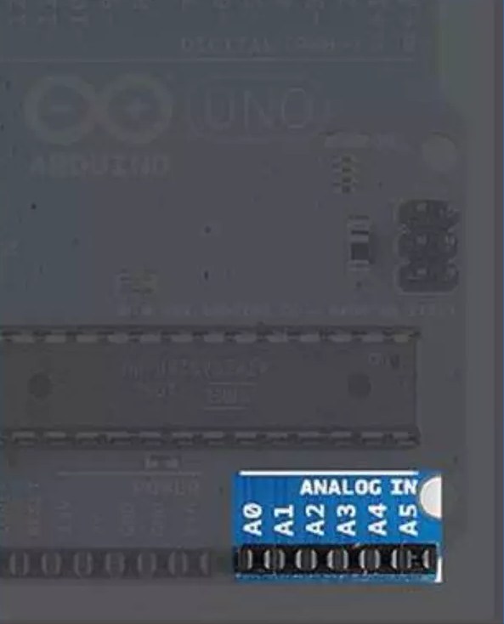
Analog Input pins
The Arduino UNO board has 6 analog input pins, labeled "Analog 0 to 5." These pins can read the signal from an analog sensor like a temperature sensor and convert it into a digital value so that the system understands. These pins just measure voltage and not the current because they have very high internal resistance. Hence, only a small amount of current flows through these pins.
Although these pins are labeled analog and are analog input by default, these pins can also be used for digital input or output.

Slide 13
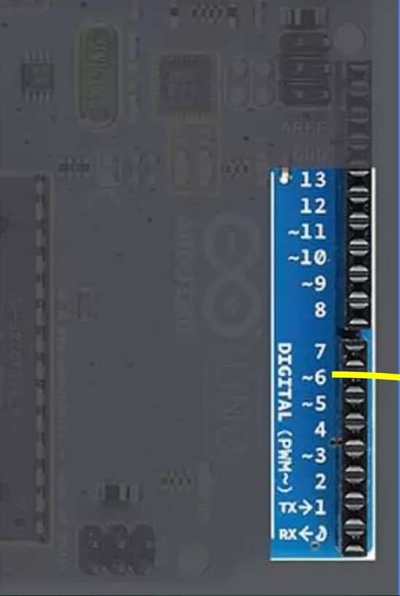
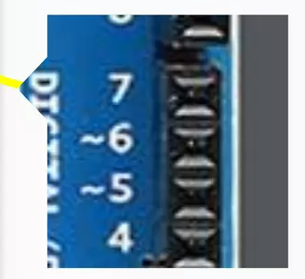
Digital Pins
You can find these pins labeled "Digital 0 to 13." These pins can be used as either input or output pins.
When used as output: pins act as a power supply source for the components connected to them. (supply 4 mA of current at 5 V)
When used as input: they read the signals from the component connected to them.
Some of the digital pins are labeled with tilde (~) symbol next to the pin numbers (pin numbers 3, 5, 6, 9, 10, and 11). These pins act as normal digital pins but can also be used for Pulse-Width Modulation (PWM), which simulates analog output like fading an LED in and out.

Slide 14
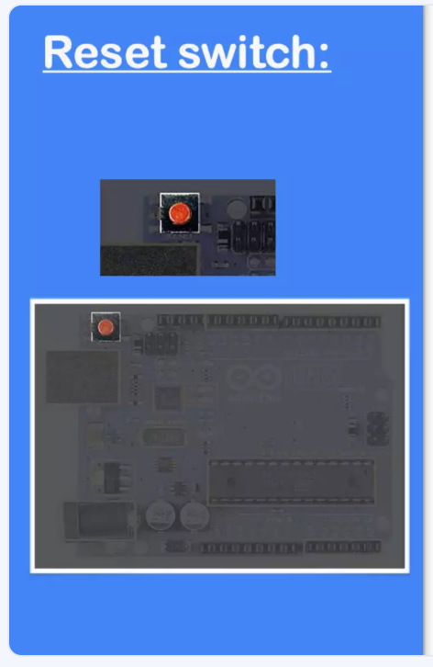
When this switch is clicked, it sends a logical pulse to the reset pin of the Microcontroller, and now runs the program again from the start. This can be very useful if your code doesn't repeat, but you want to test it multiple times.

Slide 15
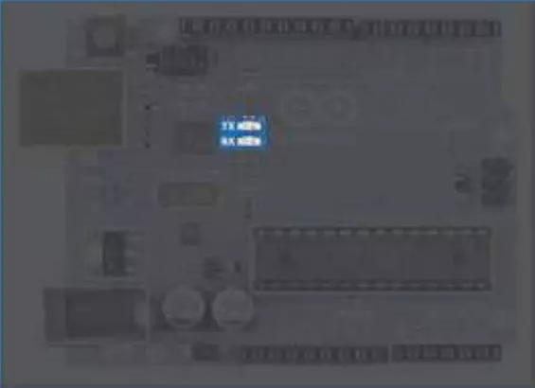
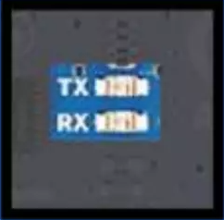
TX - RX LEDs:
TX stands for transmit, and RX for receive. These are indicator LEDs which blink whenever the UNO board is transmitting or receiving data.

Slide 16
Basic code structure
void setup()
{
Statements;
// runs once when the board powers up or resets
}
void loop()
{
Statement; // runs repeatedly after setup()
}

Slide 17
pinMode(pin, mode) – Sets a digital pin as INPUT, OUTPUT, or INPUT_PULLUP.
digitalWrite(pin, value) – Writes HIGH or LOW to a digital output pin.
digitalRead(pin) – Reads the current state (HIGH or LOW) of a digital input pin.
analogRead(pin) – Reads an analog input (0 to 1023) from a pin like A0, A1, etc.
analogWrite(pin, value) – Outputs a PWM signal (0 to 255) on a pin (like dimming LED).
delay(ms) – Pauses the program for a given number of milliseconds.
millis() – Returns the number of milliseconds since the Arduino started running.
Serial.begin(baudrate) – Starts serial communication at a set baud rate (e.g. 9600).
Serial.print(data) – Prints data to the serial monitor without a newline.
Serial.println(data) – Prints data to the serial monitor with a newline.
Serial.read() – Reads incoming serial data (1 byte at a time).
Serial.available() – Checks how many bytes are available to read from serial.
random(max) – Returns a random number between 0 and max - 1.
random(min, max) – Returns a random number between min and max - 1.

Slide 18
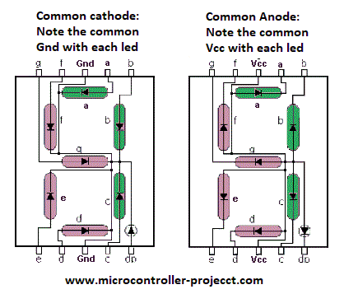
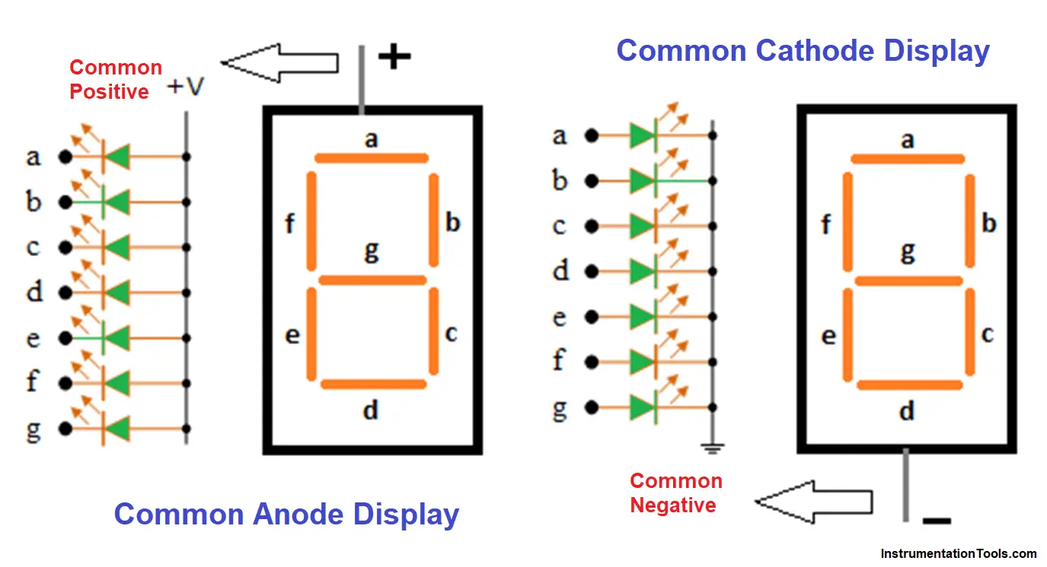
Notes:
Our lab’s 7 segment displays are common Anode .Receiving 0 in the pins will activate the diodes

Slide 19
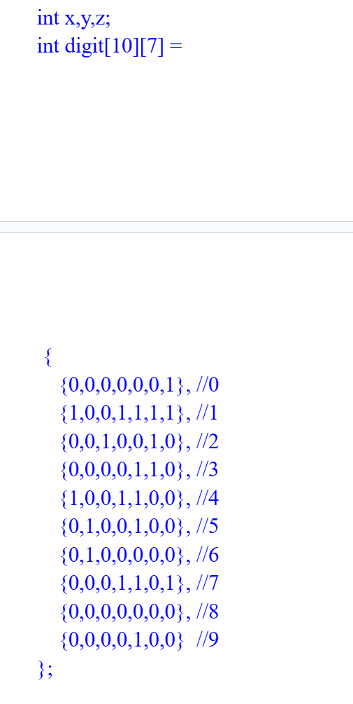
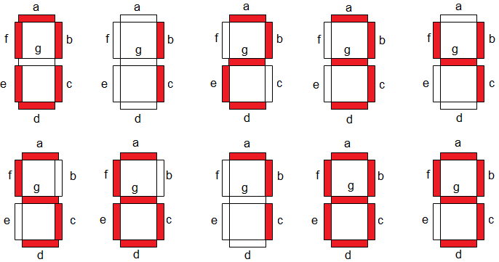

Slide 20
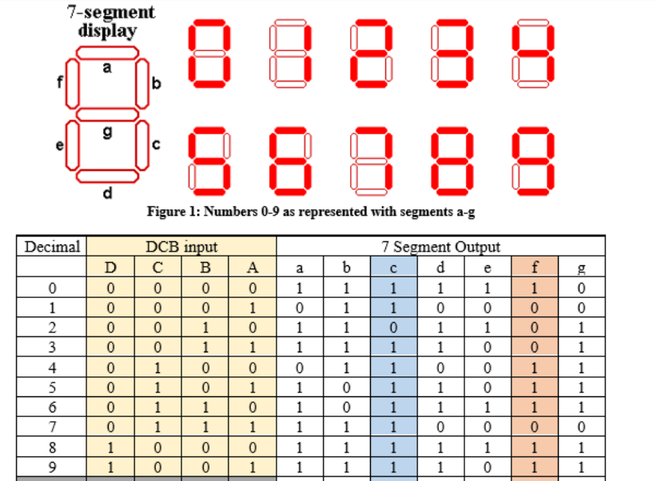

Slide 21
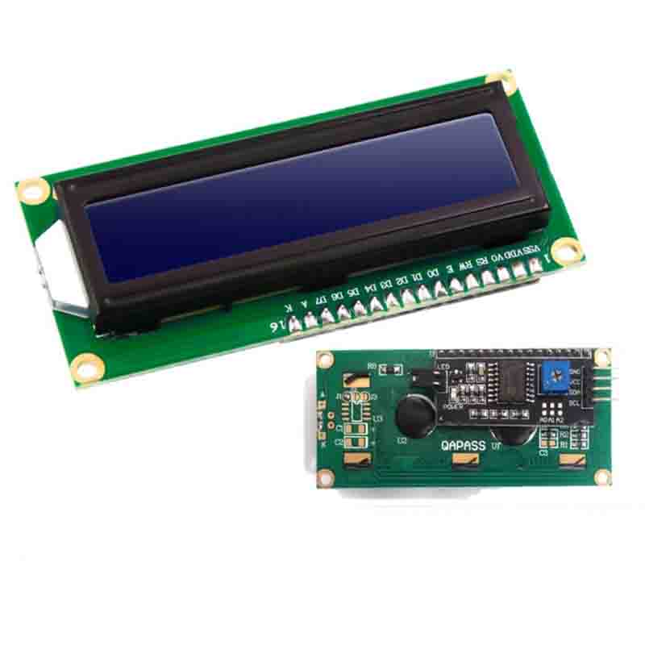
Notes:
Do you know why there are separate VDD, VSS and A,K pins when there could have been only one ? Ans: VSS – connected to GND and VDD — connected to 5v is used to power the logical circuit inside the LCD. However, the A, Anode and K, cathode is connected to the 5v and GND respectively to power the LEDs behind the LCD. They are separate because if needed we can apply PWM to the leds to increase and decrease the brightness or even consume less power. Moreover, the power fluctuations caused is not suitable for the logical circuit in the LCD, so they are separate. LiquidCrystal(rs, enable, d4, d5, d6, d7) –Half byte mode. V0 -Contrast control pin. Connect to a potentiometer to adjust text contrast. RS (Register Select) Selects the register:
→ 0 = Command (Instruction)
→ 1 = Data (Character to display) E (Enable) -Triggers the LCD to read data from the data pins when it transitions from HIGH to LOW. Acts as a latch. 8-Bit Mode (Full Byte Mode)
Sends all 8 bits of a byte at once.
Requires 8 data pins (D0 to D7) connected between the Arduino and the LCD.
Each command or character is sent in one step.
Faster communication because the full byte is transferred in one go.
Downsides:
Uses more Arduino pins (6 data + RS + E = 8 pins total).
Arduino Uno has limited pins, so using 8-bit mode may restrict other features or peripherals.
4-Bit Mode (Half Byte Mode)
Sends only 4 bits at a time (half of a byte).
Uses only the higher 4 data pins: D4, D5, D6, D7.
Each byte is split into two 4-bit parts (nibbles).
First, the higher nibble (4 bits) is sent, then the lower nibble.
Requires only 6 Arduino pins total (4 data + RS + E).
Trade-off:
Slightly slower, because each byte needs two transmissions.
But more efficient for pin usage.

